Slide 1
Big Data Showcase – Group2
Sailaja Vuyyuru
Jerry JacoB
Purna Chandra Kuntla

Slide 2
Introduction
How Uber uses data to improve their service and create the new wave of mobility
Big Data Processing
Navigation
Matching and ETA
Surge Pricing
Data Visualization
Uber movement service helping cities to adapt to existing infrastructure and invest in future solutions.

Slide 3
Uber Big Data
Collects and uses large volume of data
Processing the data with high velocity
Available in more than 820 cities across 173 countries
Has 3 million active drivers
Uber drivers around the world complete 15 million rides a day.
100+ petabytes with minute latency

Slide 4
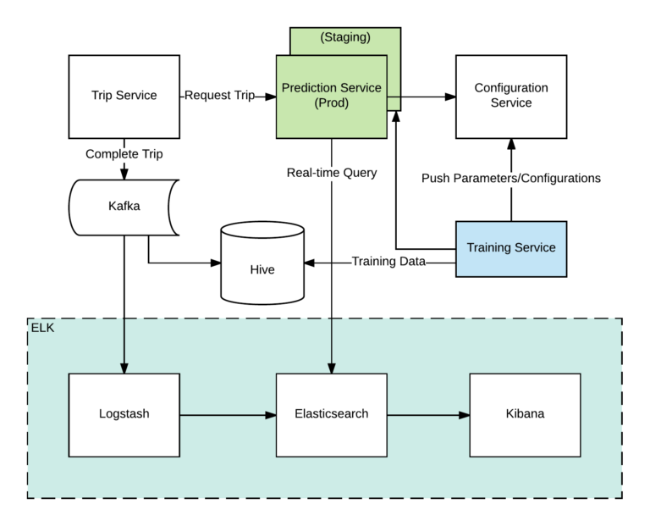
Uber Big Data Processing
ELK is an integrated solution for searching and analyzing data in real time.
Trip service
Training service
Configuration service
Prediction service
KNN on similar historic trips over a period of time and then performs a regression on them to create a prediction

Slide 5
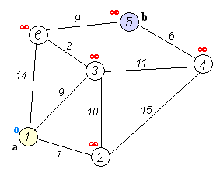
Uber Navigation
Base level algorithm is Shortest Path algorithm
Edge weights are applied based on the variables like traffic lights, number of lanes, city roads or highways, etc.
Once Uber has enough historical and real time data of similar routes in time and space, it makes adjustment to those original cost estimates based on ML algorithms .
Edge weights will be adjusted, and graph is redrawn. Shortest path is then calculated based on the final weights.

Slide 6
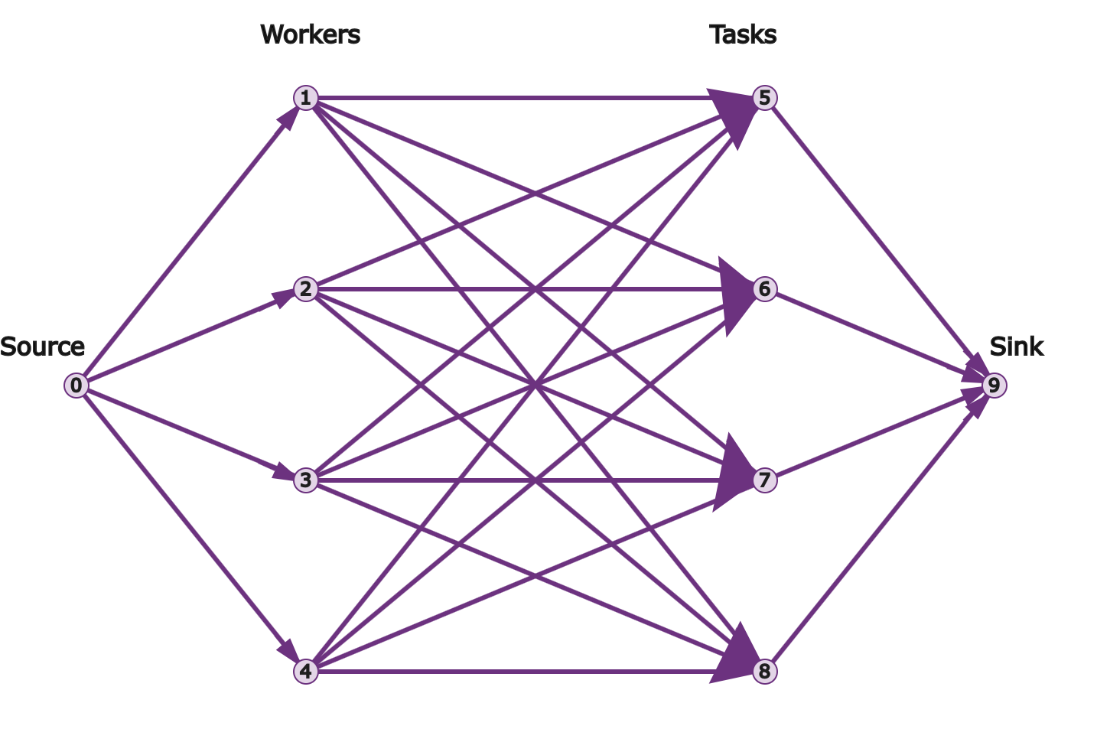
Driver-Rider Matching and ETA
Linear Programming Problem
Assignment of workers(Drivers) to nearby tasks (Pick-up’s) as a minimization of wait time (cost).
These edges would then be attributed some value based on ML that denotes the cost of the worker completing the task.
The solution to this problem would be the Estimated Time of Arrival.

Slide 7
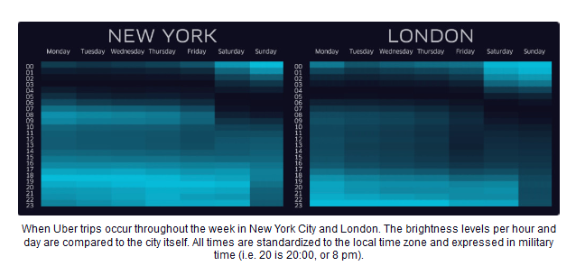
Uber Surge Pricing (GeoSurge)
Classic economics: The increase in price is proportionate to demand.
Increased prices encourage more drivers to go online. Prices gradually come down with additional supply of drivers.
Supply and demand data are not the same from city to city, so Uber engineers devised a way to map the “pulse” of a city to connect drivers and riders more efficiently

Slide 8
Data Visualization
Uber offers an open source version of the data visualization framework it uses internally, called deck.gl. The tool was made available to anyone via open source
In 2018 Uber released Kepler.gl, an advanced exploratory analysis tool for geospatial data which was very well-received by our customers.
Uber further expanded in 2018 with a deeper integration with deck.gl.
geospatial visualization
real-time positioning of vehicles
identify gaps in the rider pick-up experience
interpret systems like routing, navigation, and dispatch

Slide 9
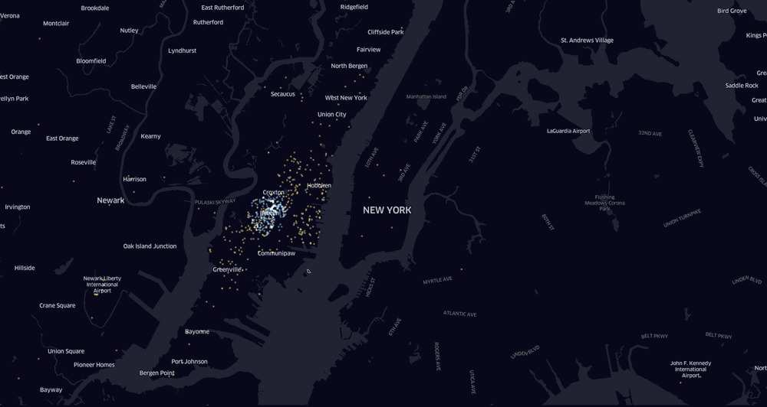
Mapping Applications for City Ops Teams and General Managers

Slide 10
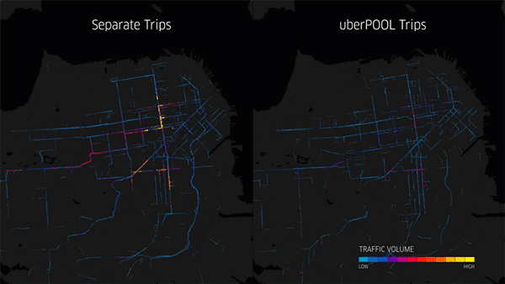
Data Visualization
Data Visualization also helps the public better understand what Uber does and how it works
How uberPOOL helps reduce traffic

Slide 11
Uber movement service
Travel Times
A public dataset measuring zone-to-zone travel times across city
Speeds
A public dataset measuring street speeds across a city to enable data-driven city planning
New mobility
A metrics driven dataset for city managers to understand dockless bike and scooter programs

Slide 12
Conclusion
Uber improved their data platform from a few terabytes to over 100 petabytes while reducing data latency from 24+ hours to minutes
Uber teaches us a great deal about using big data – and not just sitting on it. They also teach us to look for connections in every possible ounce of that data.
Every time you’re collecting information but not using it, there’s the potential for a missed opportunity to grow and improve your business.

Slide 13
References
https://eng.uber.com/uber-big-data-platform/
https://eng.uber.com/elk/
https://movement.uber.com/?lang=en-US
https://carsurance.net/blog/uber-statistics/
https://towardsdatascience.com/assigning-fastest-pick-ups-to-uber-drivers-with-linear-programming-8f8bd3c44c9a
https://eng.uber.com/engineering-an-efficient-route/
https://eng.uber.com/uber-visualization-2018/

